Slide 1

Los Angeles Home Prices Study
Team Profit Prophets - Tom Chang, Nicola Lin, Raj Penta and Marvin Gomez

Slide 2
What affects housing prices
Background
Hypothesis
Questions
Los Angeles housing prices are on the rise! As a data analytics team, two metrics have been identified to find a relationship between the metrics and housing prices.
Healthy restaurants and lower crime rates are more common in cities with higher median home prices than cities with lower median home prices .
What are the changes in home median prices over time for cities in Los Angeles County?
Are there more healthy restaurants in cities with higher median home prices?
Is there an observable trend between home value and number of crimes reported?
Notes:
Why we are asking these questions

Slide 3

Satisfied with our findings?
We did find observable trends, however we do not have statistical evidence to be entirely satisfied with our findings.

Slide 4

Starting point
To answer what metrics affect housing prices we first came up with a list of factors that we believed could affect housing prices. Which look liked...
- home depot concentration in a city; google map api
- churches; crime rate; home prices
- pollution levels (X)
- types of businesses:
- 24 hour fitness (gyms nearby)
- food delivery accessibility
- new construction: home construction; new
- public transportation; time series; increase in traffic > increase in home prices??
- rental/leasing property prices; how does it affect home prices:
- corporation stock prices
- hotels; quality of hotels; how many stars
- density: construction, population,
- veterinarians located in an area; pets
- offices and home prices in the area;
- population density

Slide 5

The Process Continues
From the list we whittled down to a few options that were most interesting or ones that we believed had the most influence on housing prices. Crime rate and organic restaurants emerged to be the victors and next we were on the hunt for data.

Slide 6



Data Sources
Los Angeles County Sheriff's Department

Slide 7
Data Cleanup and Exploration
Merge datasets
Converting values into different data types
Filtering out Irrelevant Data
Grouping data
Missing data
Generate random sample from entire dataset
While using google api, we had to call in a secondary data set since it defines location based on longitude and latitude.

Slide 8
Data Analysis
Notes:
Discuss the steps you took to analyze the data and answer each question you asked in your proposal
Present and discuss interesting figures developed during analysis, ideally with the help of jupyter notebook

Slide 9

Organic Restaurants
Is there a relationship between housing prices and the amount of organic restaurants in its vicinity?
What are the ratings of organic restaurants in cities with median high/low valued housing prices?

Slide 10
Data Source
Google Place API
2. Zillow Single Family House price
2018-05.csv
3. Zip code Latitude Longitude City state county.csv (From Gaslamp media)
Params={ “rankby:”distance”,
“Type”:”restaurant”,
“Keyword:”organic”,
}

Slide 11
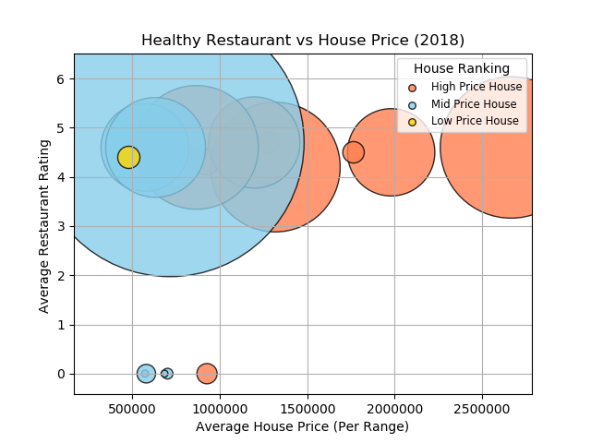
X-Value: Average house price by three category
Y-Value: Organic Restaurant Rating
Bubble Size: total counts of the organic restaurants
Notes:
Categorized three types of house value : High Mid and Low
Red Bubble means High Price House
skyblue Bubble means Mid Price House
Yellow Bubble means Low Price House
We can see the high value house does have more organic restaurants counts. But the mid price house area seems have more organic restaurants ( reason( maybe i should redefine the house price value category)

Slide 12
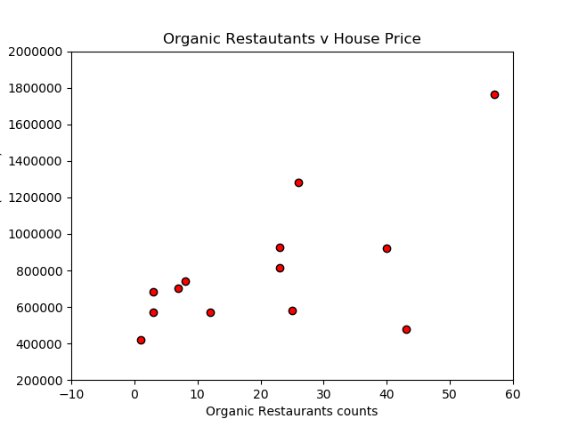
X-value: Number counts of organic Restaurants
Y-value: House Value
Notes:
From this plot. We can see the the higher house price will have more organic restaurants

Slide 13
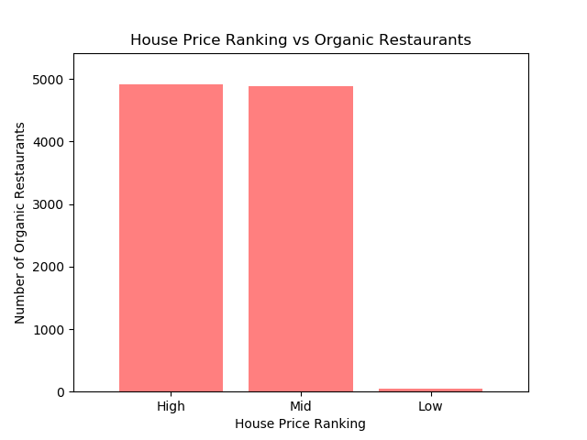
X-value:
High : House Price > $750,000
Mid : House Price > $550,000
And House Price <= $750,000
Low : House Price <= $550,000
Y-value:
Number of Organic Restaurants
Notes:
I was using google api.
Limitation?
Difficulty

Slide 14
Roadblocks
1.Not having enough data sample (Google Place API limitation)
2.Searching area is too narrow the lat and lon wont have specifinican difference
3.I should redefine the High ,mid and low value house price?

Slide 15

Crime
Is there an observable trend in the change of crimes reported over time?
Is there a observable trend between crime rates and housing prices in the same area?
Will we find higher crime rates in areas with lower home values?

Slide 16
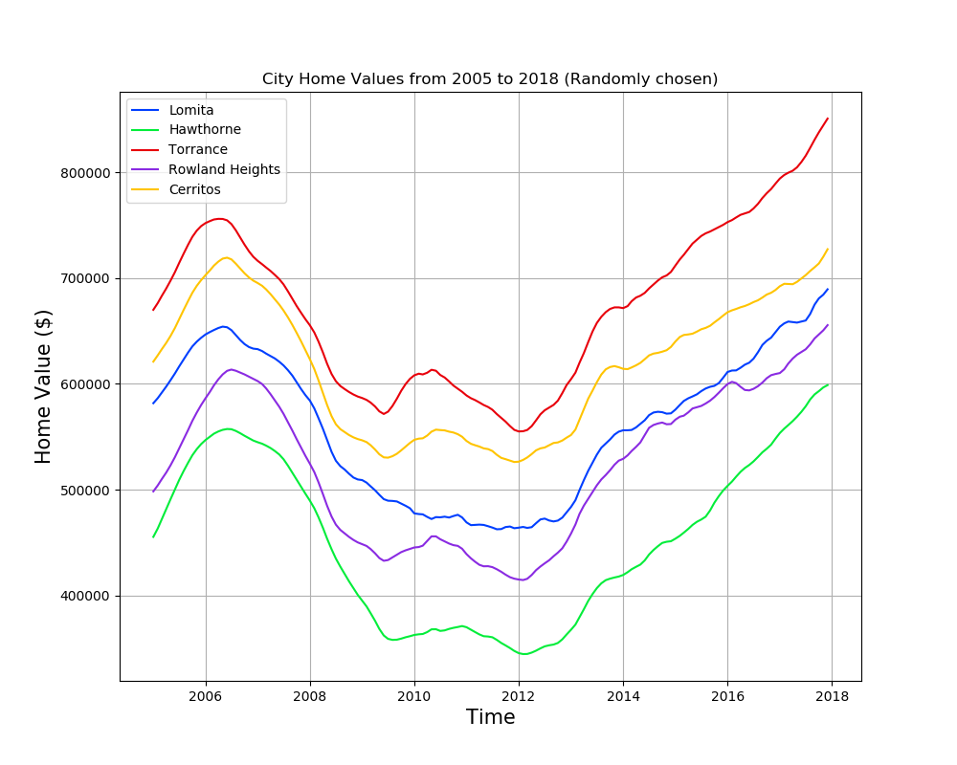
Median home prices from Zillow
Randomly generated cities
Good Spread of home values from <400k to >800k

Slide 17
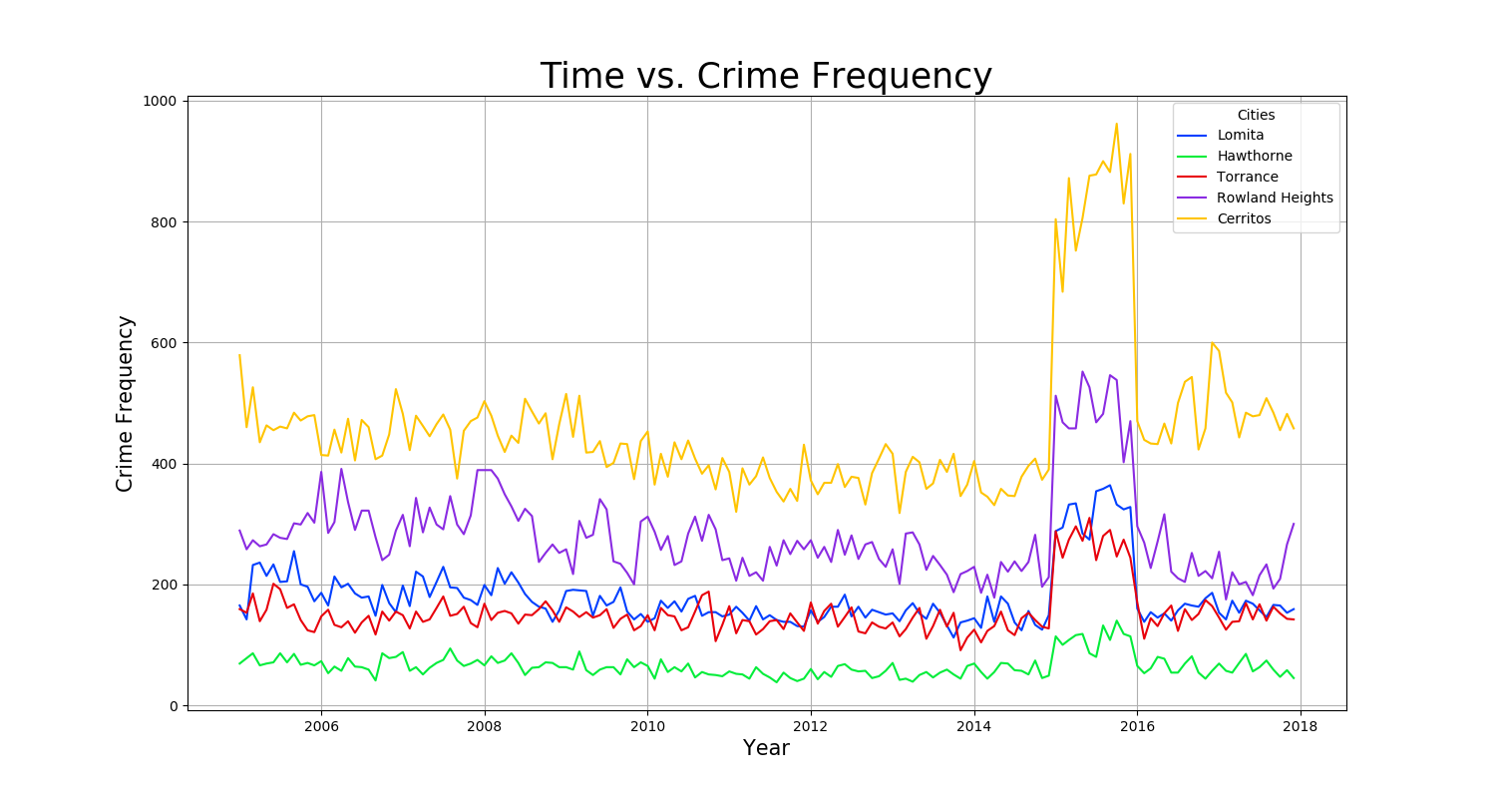
# of reported incidents
Month to month data
Great spike of 2015
Notes:
Randomly generated cities,

Slide 19
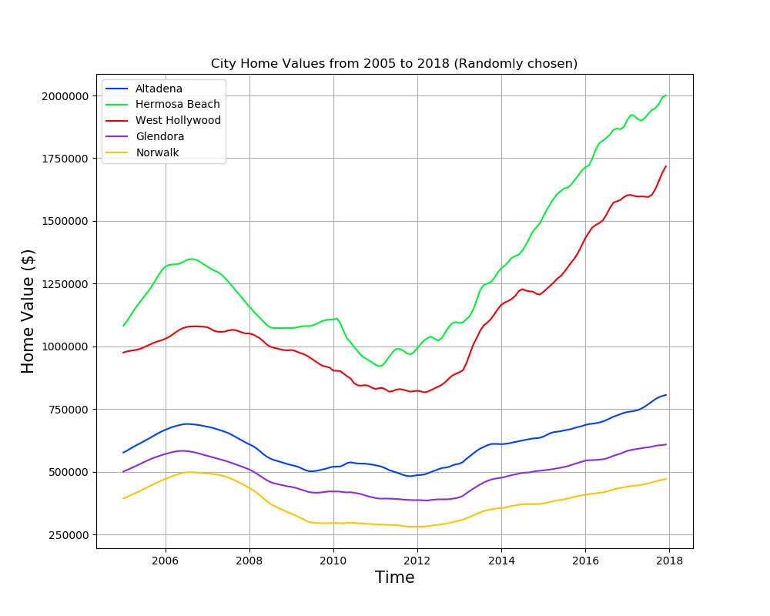

Slide 20
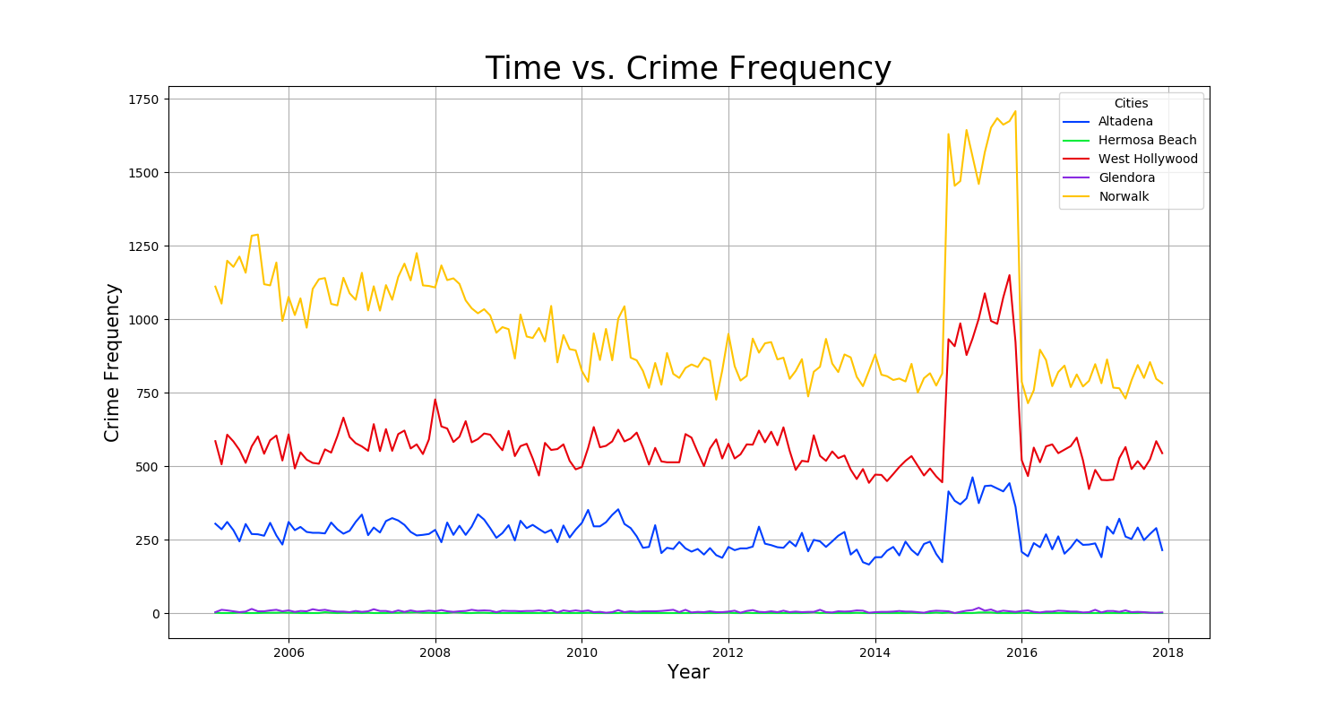

Slide 21
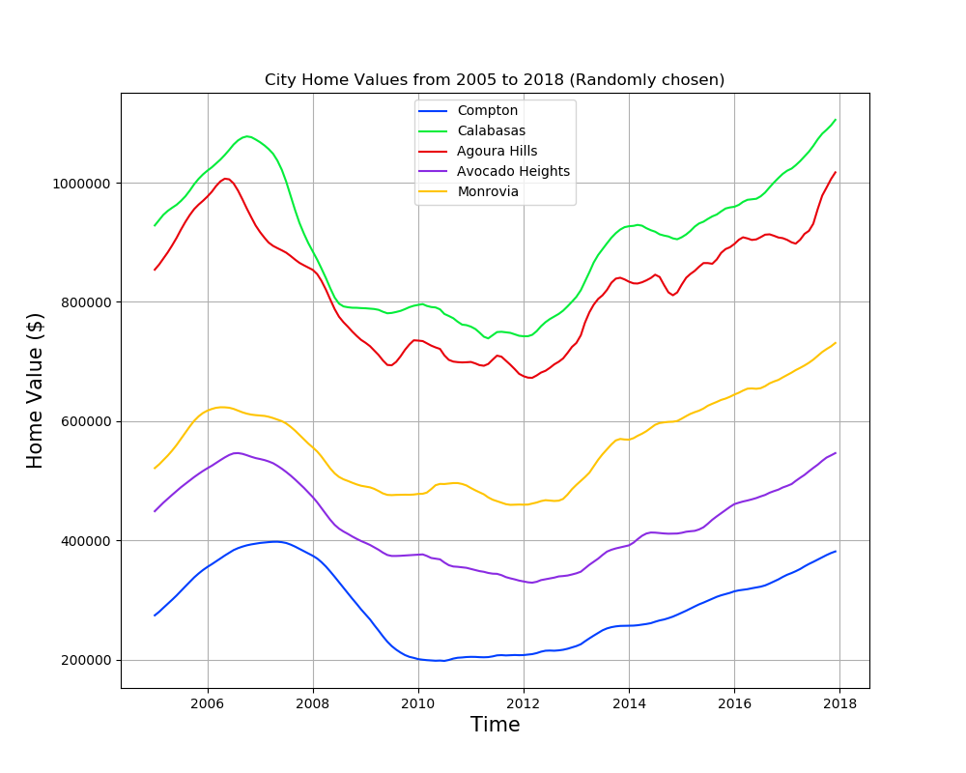

Slide 22
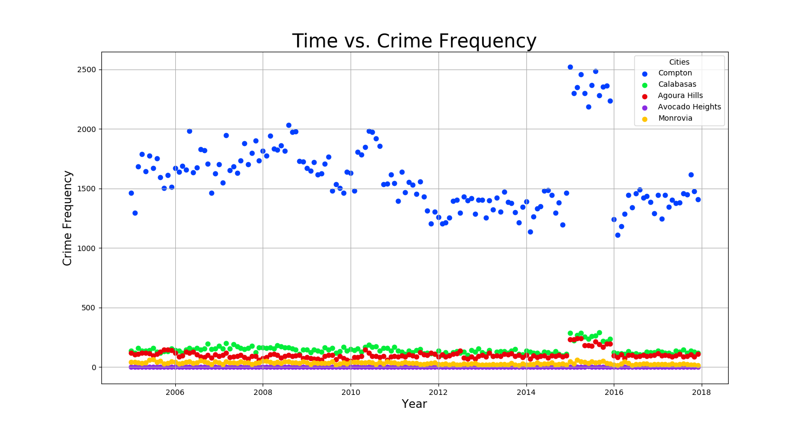
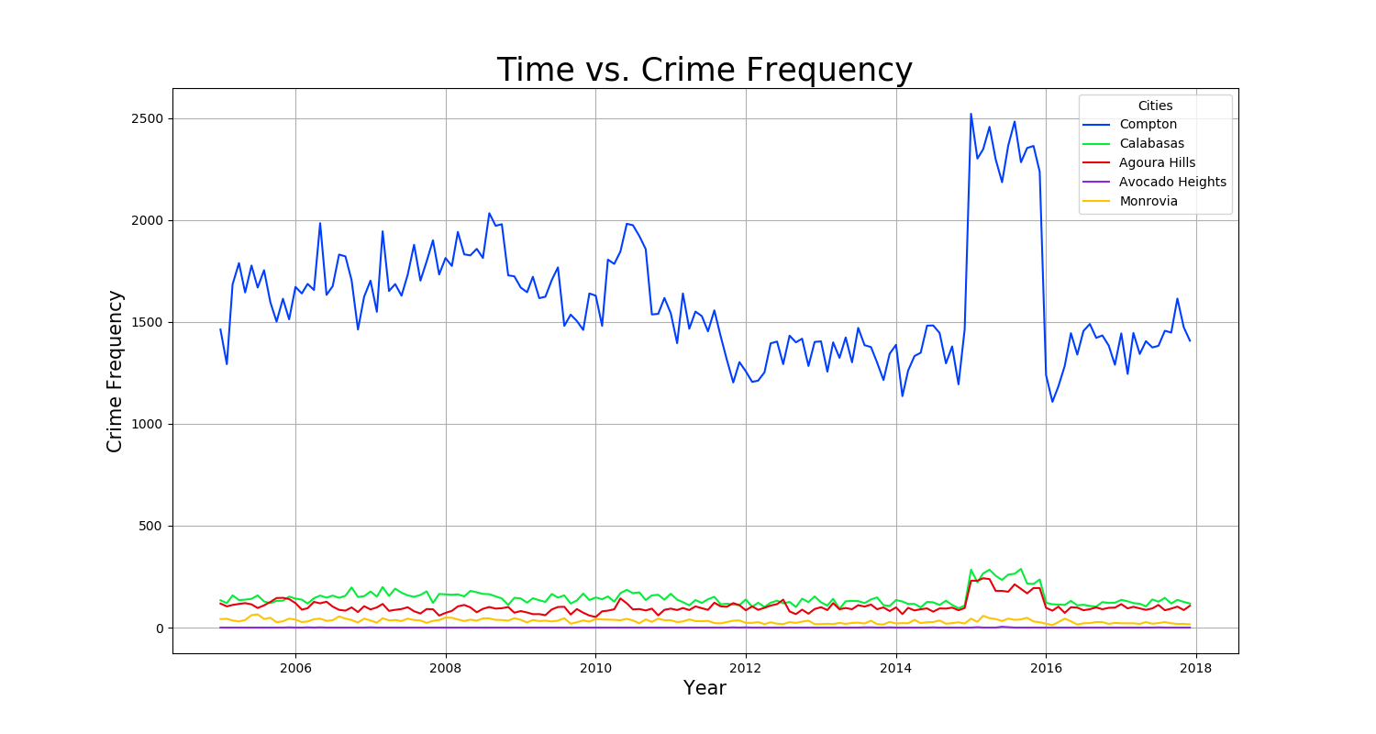

Slide 23
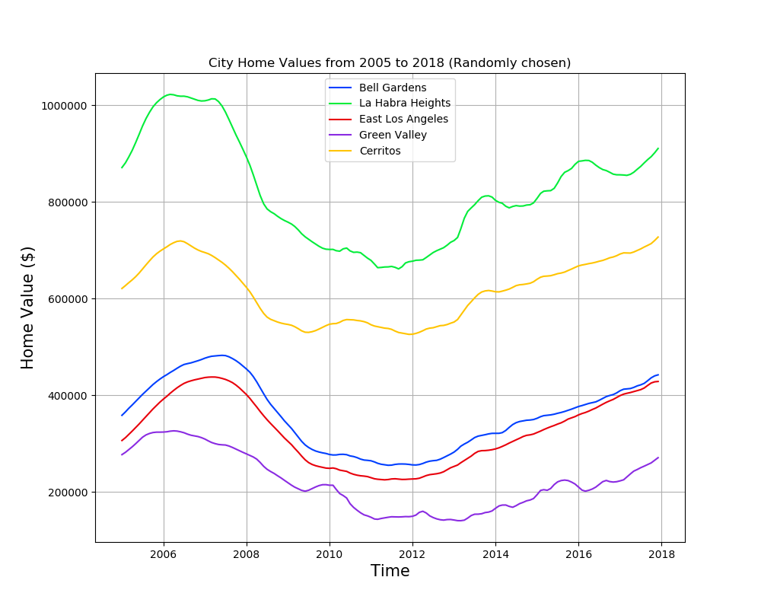

Slide 24
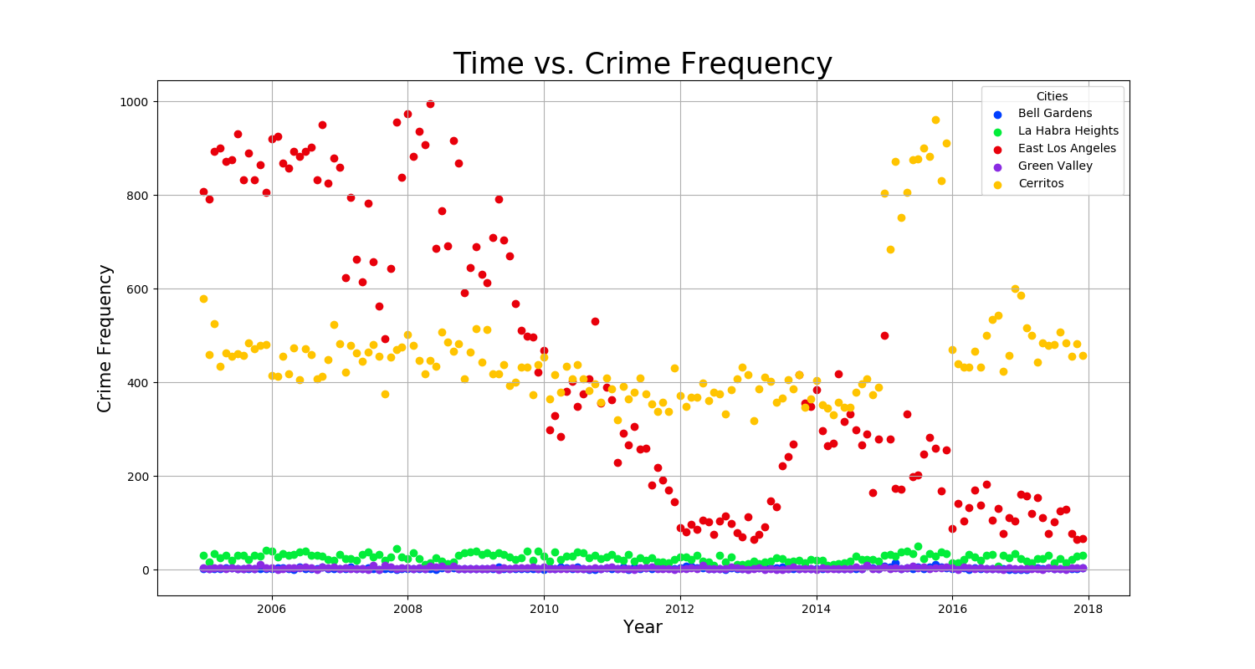
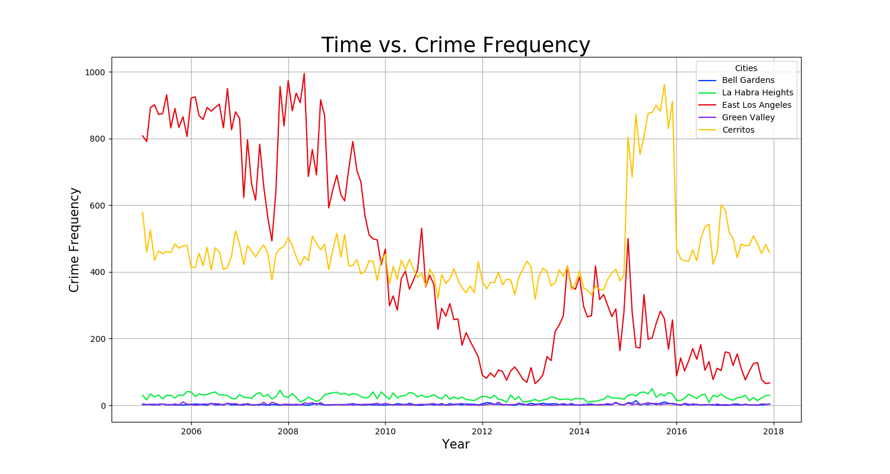

Slide 25
Limitations

Slide 26
Conclusion

